Slide 1

CFR Enhancement Session
Victor Myers, Senior Business Analyst
December 12, 2018

Slide 2
Agenda
Role call/Introductions
Provide overview of ERO Portal
Provide overview of Coordinated Functional Registration (CFR)
Define User Acceptance Testing (UAT) & Timeframe
Discuss what functionality needs to be tested
Discuss process for reporting issues

Slide 3
What is ERO Portal?
A tool that currently allows users:
  Register
    Login
    Forgot password
    Forgot username
  Self Service
    Change password
    Update security questions
    Change email
  Request Access to NERC Resources
    View a list of NERC applications or email lists you have access
    Request removal

Slide 4
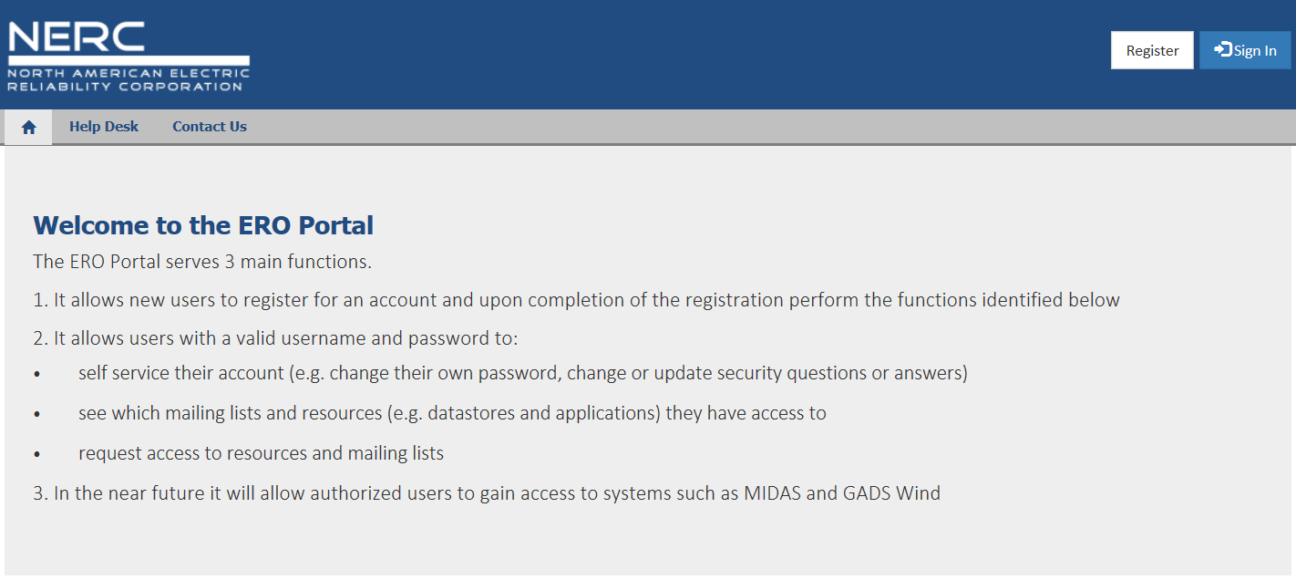
ERO Portal Website
Registered Entity or Regional Entity users will go to the following website to Register.
  https://eroportalstg.nerc.net (test environment)

Slide 5
User Registration

Slide 6
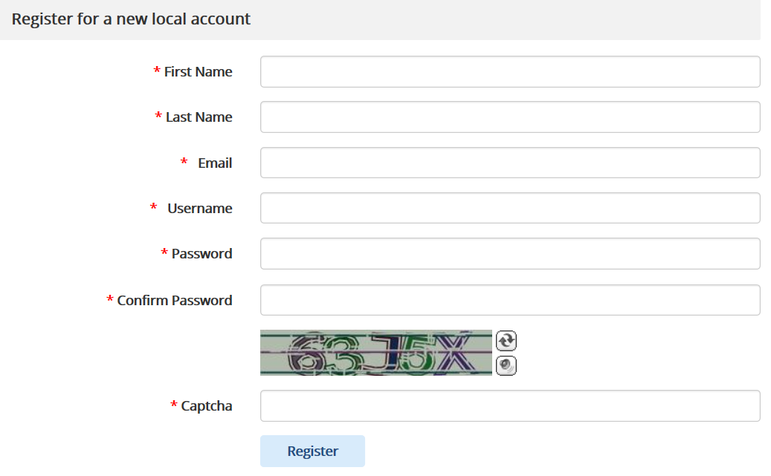
Registration
Complete all fields, select “Register
  Unique Email address
  Unique Username (Max. 25 characters)
  Password Requirements:
      Minimum of 8 characters long
      Must contain at least 1 number
      Must contain at least 1 lowercase letter
      Must contain at least 1 uppercase letter
      Must contain at least 1 special character (!,@,#,$,%,^)

Slide 7
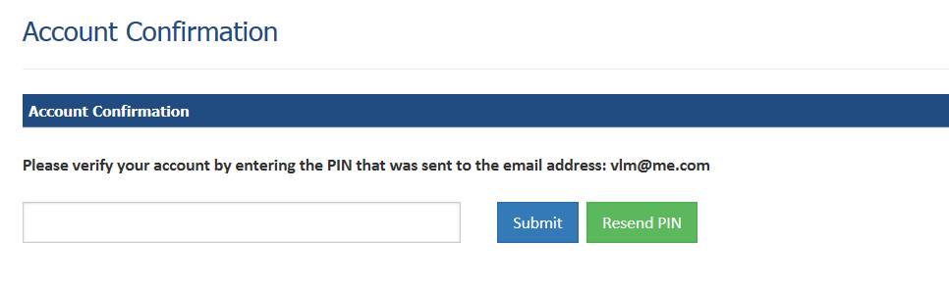
Confirm Email Address
After clicking “Register”, the system sends a 6-digit pin to the email address provided
  Enter Pin and select “Submit”

Slide 8
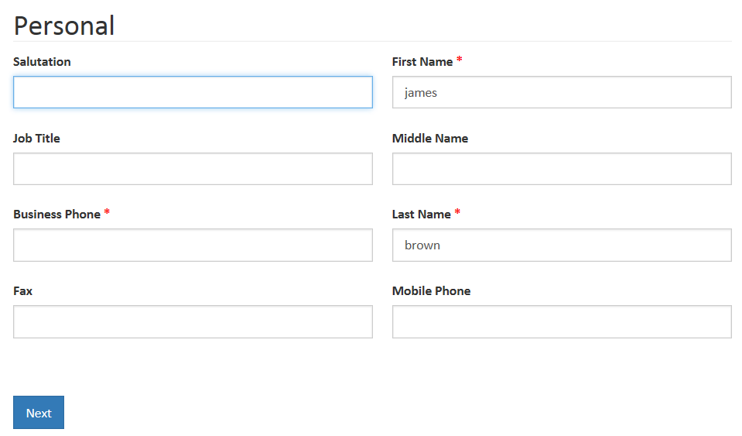
Provide Demographic Data
After clicking the “Submit”, the system loads the following page, for users to provide additional data select “Next”

Slide 9
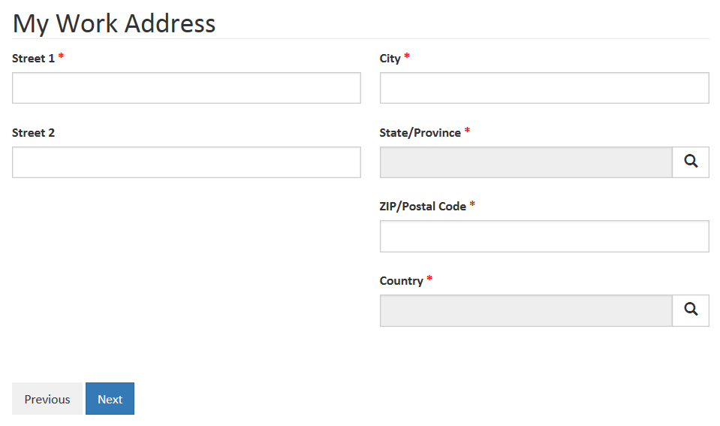
Provide Work Address
After clicking the “Next”, the system loads, provide work address

Slide 10
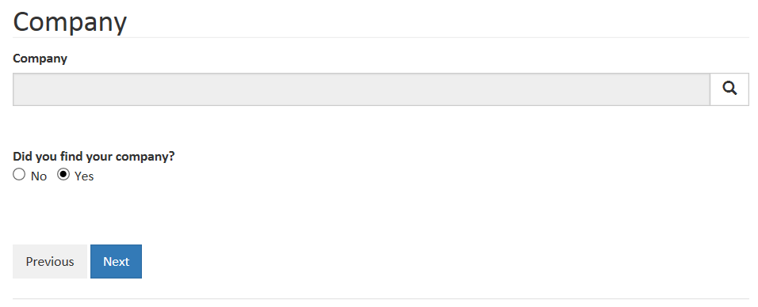
Provide Name of Company
After clicking the “Next”, the system loads the following page, user has the option of associating their profile to a company

Slide 11
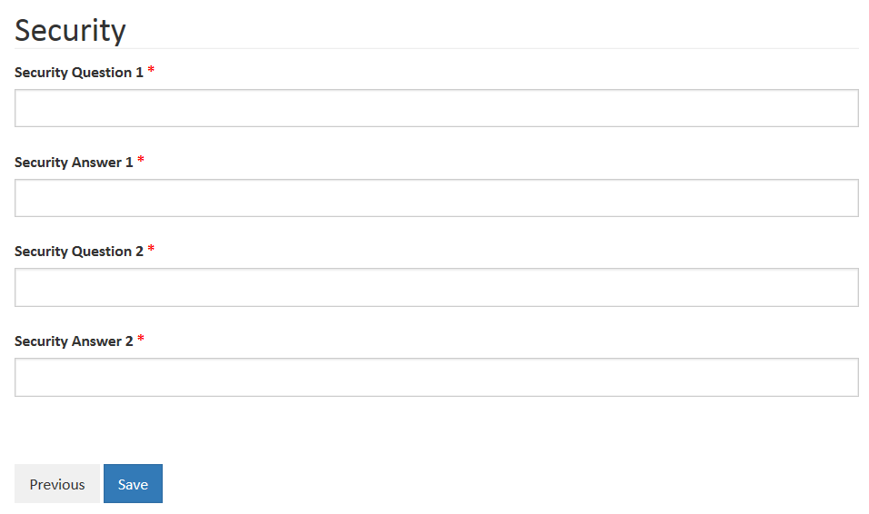
Security Questions and Answers
After clicking the “Next”, the system loads the following page, and awaits user input

Slide 12
Registration Complete
After clicking the Save button the system lets you know you have completed the registration process

Slide 13
User Sign In

Slide 14
ERO Portal Sign In
Click “Sign In”

Slide 15
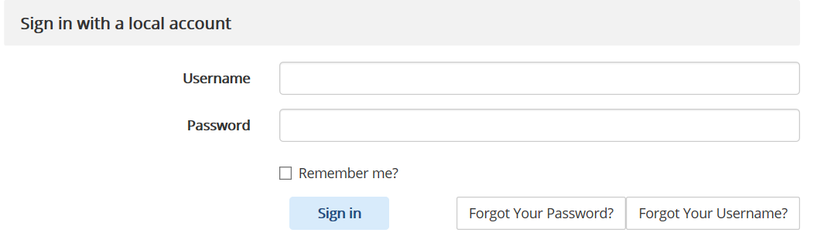
Signing In
Enter a valid username and password
If user forgets either the username or password
  Click “Forgot Your Username”
  Click “Forgot Your Password”

Slide 16
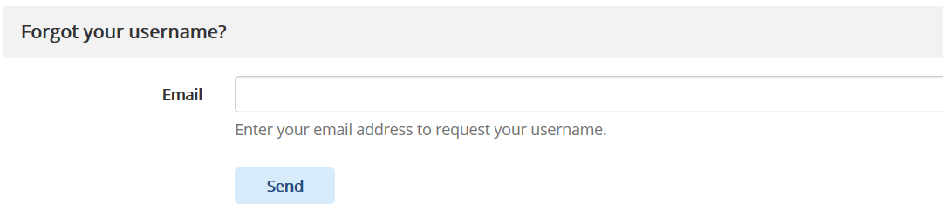
Forgot Your Username
  Provide email address used to create account
  User receives email with Link
  User clicks on the link, provides answers to security questions
  If answers are correct, user is shown his/her username

Slide 17
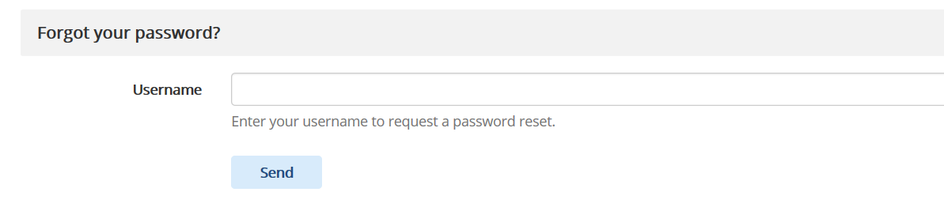
Forgot Your Password
  Provide username
  User receives email with Link
  User clicks on the link, provides answers to security questions
  If answers are correct, the user is allowed to change their password

Slide 18
ERO Portal Profile Management

Slide 19
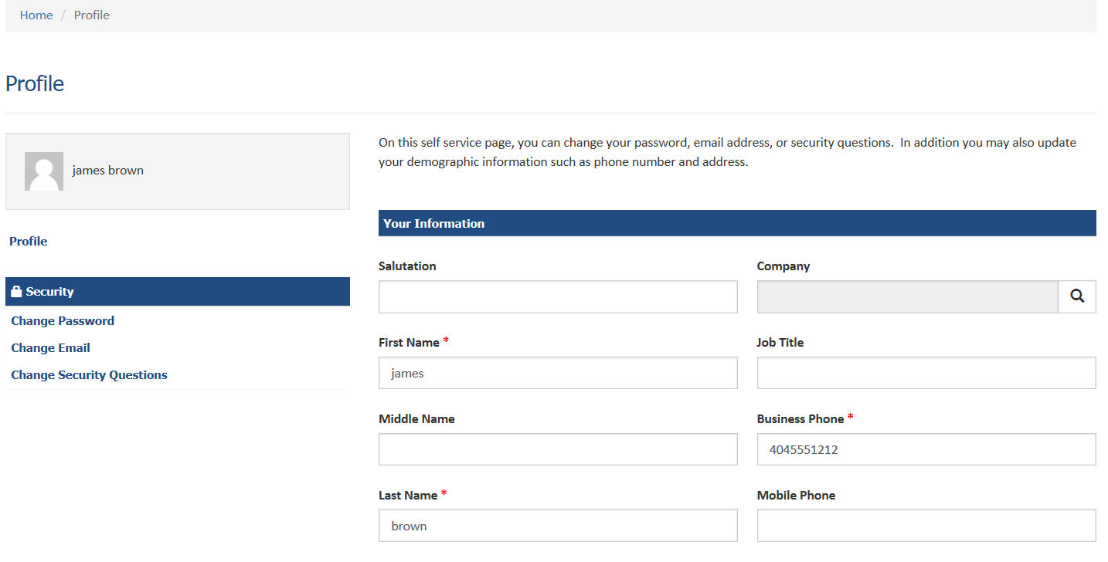
ERO Portal Profile
Clicking “My Profile” displays the following

Slide 20
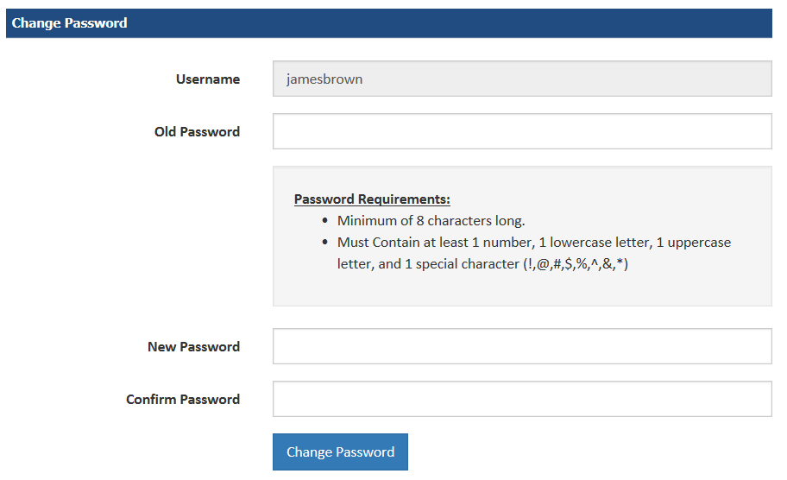
ERO Portal Profile Change Password
Click “Change Password” displays the following

Slide 21
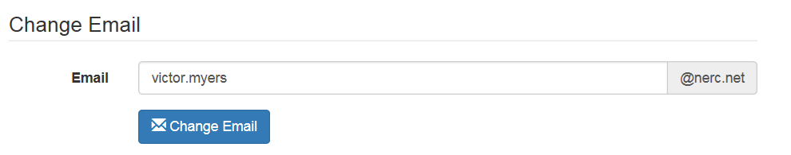
ERO Portal Profile Change Email
Click “Change Email” displays the following

Slide 22
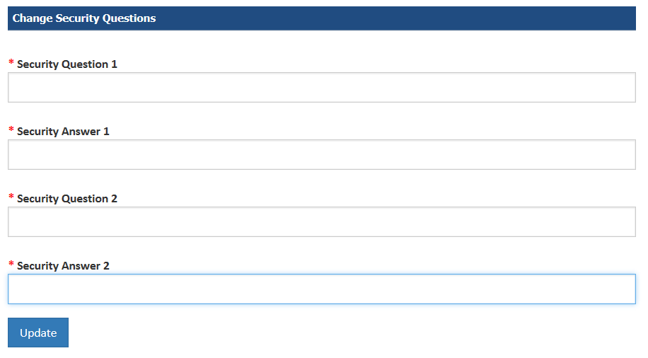
ERO Portal Profile Change Security Questions
Click “Change Security Questions” displays the following

Slide 23
ERO Portal NERC Resource Access

Slide 24
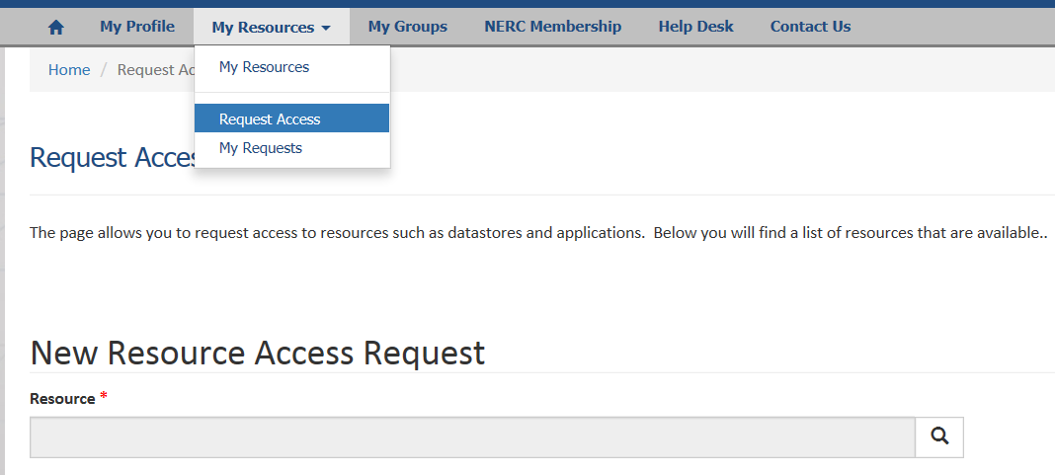
Request Access to Systems/Applications
Click down arrow beside My Resources and choose “Request Access” and the following displays
Click on the magnifying glass and list of NERC applications (resources) appears that you can request access to

Slide 25
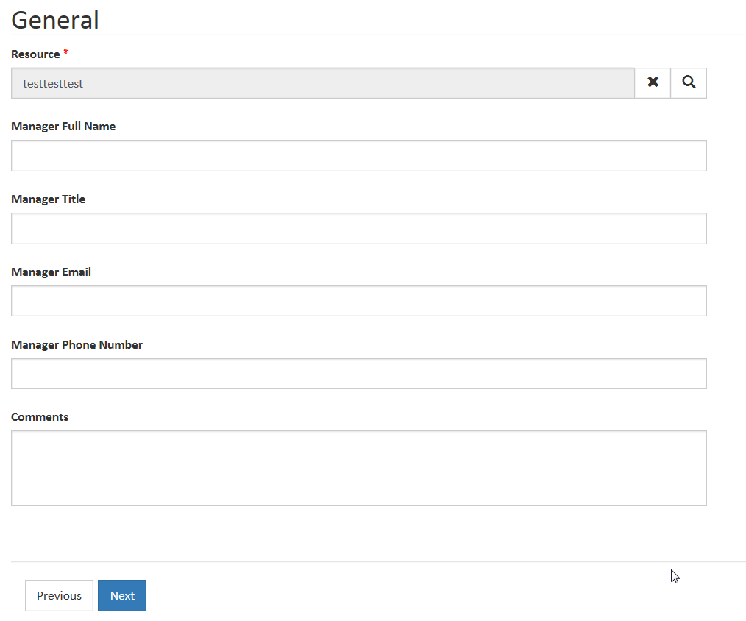

Request Access to Systems/Applications
Provide Information about your manager
Click “Next” to continue and Submit your request

Slide 26
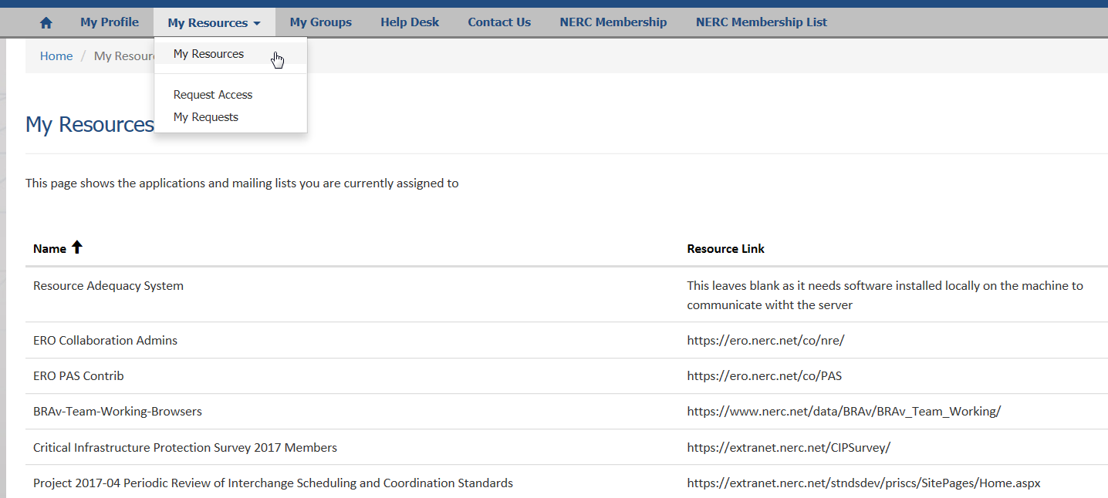
My Access
Click on the arrow beside “My Resources” and choose “My Resources” displays the following

Slide 27
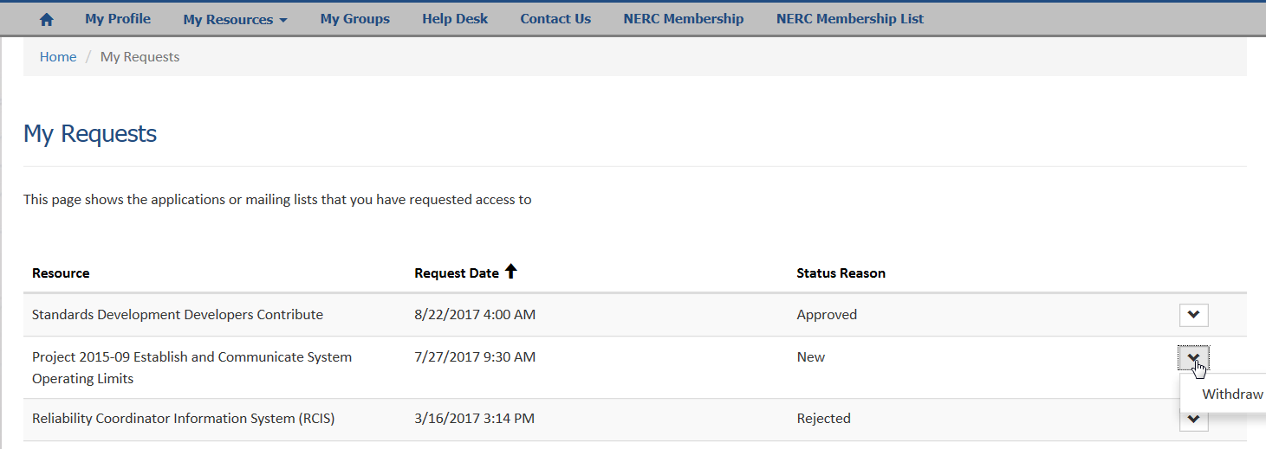
Status of My Requests
Click on the arrow beside “My Resources” and choose “My Requests” displays the following

Slide 28
User Acceptance Testing (UAT)
Details

Slide 29
User Acceptance Testing
What is UAT?
  Testing the newly developed application to ensure it allows the end users to perform their existing business tasks
Dates
  11/27 – webinar 11a-12p
  11/27 – webinar 2p-3p
  11/29 – webinar 1p-3p
  11/30 – webinar 10a-12p
  12/7 – UAT approval
Your involvement
  Test the parts of the application that are applicable to you
  Provide me with details of what you tested and the outcome
    I will report all defects to development for investigation/resolution

Slide 30
CFR Functionality

Slide 31
CFR Functionality
Create a new CFR Registered Entity user
  Select/De-Select Requirement Parts (brand new functionality)
View an existing CFR Registered Entity user
  View CFR Matrix
  Upload CFR documents
  Transfer CFR POC
  Modify Entity Participant(s)
  Modify contact(s) of Entity Participant(s)
  Modify standards associated to CFR
    Modify requirement parts associated to CFR (brand new functionality)
  Modify CFR Responsibility set
    Including responsibility set of the requirement parts (brand new functionality)
  Request Feedback from Regional Entity
  Respond to Feedback Request submitted by Regional Entity
  Submit CFR for approval
Review CFR Regional Entity user
  Accept CFR
  Reject CFR
  Respond to CFR Feedback Request submitted by Registered Entity

Slide 32
Additional CFR Functionality
Terminate a CFR CFR POC, NERC
Request for Standard(s) update Regional Entity, NERC
Generate CFR Reports Regional Entity, NERC
Assign regional entity users to a regional team NERC
Associate contacts to an entity Registered Entity, Regional Entity, NERC
  Grant permissions

Slide 33
CFR States

Slide 34
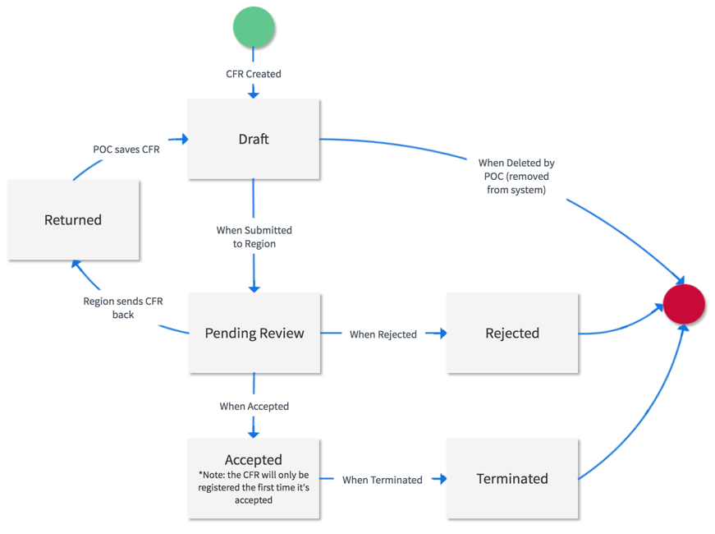
CFR States

Slide 35
CFR POC & Participant Differences

Slide 36
CFR POC Abilities
CFR POC (registered entity user who created CFR)
  While CFR Remains in Draft Status (has not been submitted to Region)
    Edit Draft
    Delete Draft
    Transfer POC
  When CFR has been submitted to Region and Region has not reviewed
    View only (no ability to make updates)
  When CFR has been submitted to Region and Region has sent CFR back with comments
    Edit Draft
    Delete Draft
    Transfer POC
  When CFR has been submitted to Region and Region has accepted the CFR
    Edit Draft
    Delete Draft
    Transfer POC
    Update Entity Contacts
  When CFR has been submitted to Region and NERC/Region has rejected or terminated the CFR
    View only (no ability to make updates)

Slide 37
CFR Participant Abilities
CFR Participant (registered entity user listed as an entity contact on a CFR)
  While CFR Remains in Draft Status (has not been submitted to Region)
    View only (no ability to make updates)
  When CFR has been submitted to Region and Region has not reviewed
    View only (no ability to make updates)
  When CFR has been submitted to Region and Region has sent CFR back with comments
    View only (no ability to make updates)
  When CFR has been submitted to Region and Region has accepted the CFR
    View only (no ability to make updates)
  When CFR has been submitted to Region and NERC/Region has rejected or terminated the CFR
    View only (no ability to make updates)

Slide 38
Creating a CFR

Slide 39
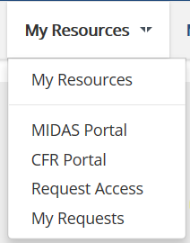
Create a New CFR
Click the arrow to the right of My Resources, a sub-menu appears and select the option for the CFR Portal
The page on the next screen opens

Slide 40
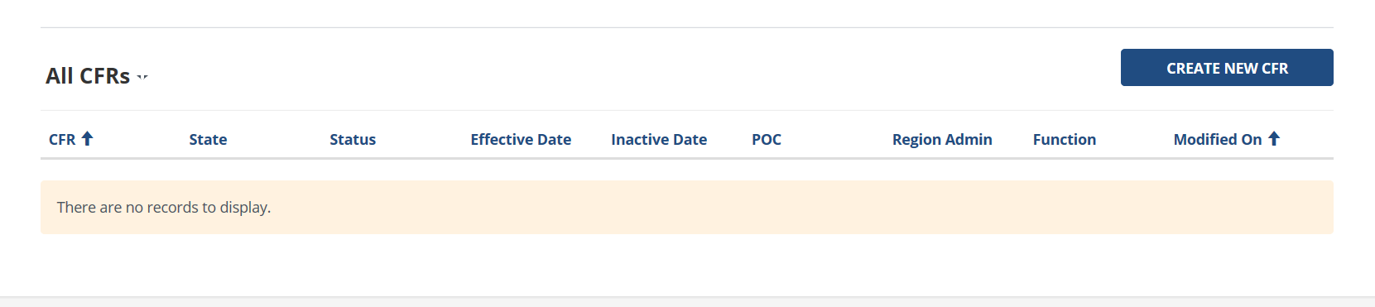
CFR Landing Page
Click the option to Create New CFR
The CFR Basic Information page loads, see the next slide

Slide 41
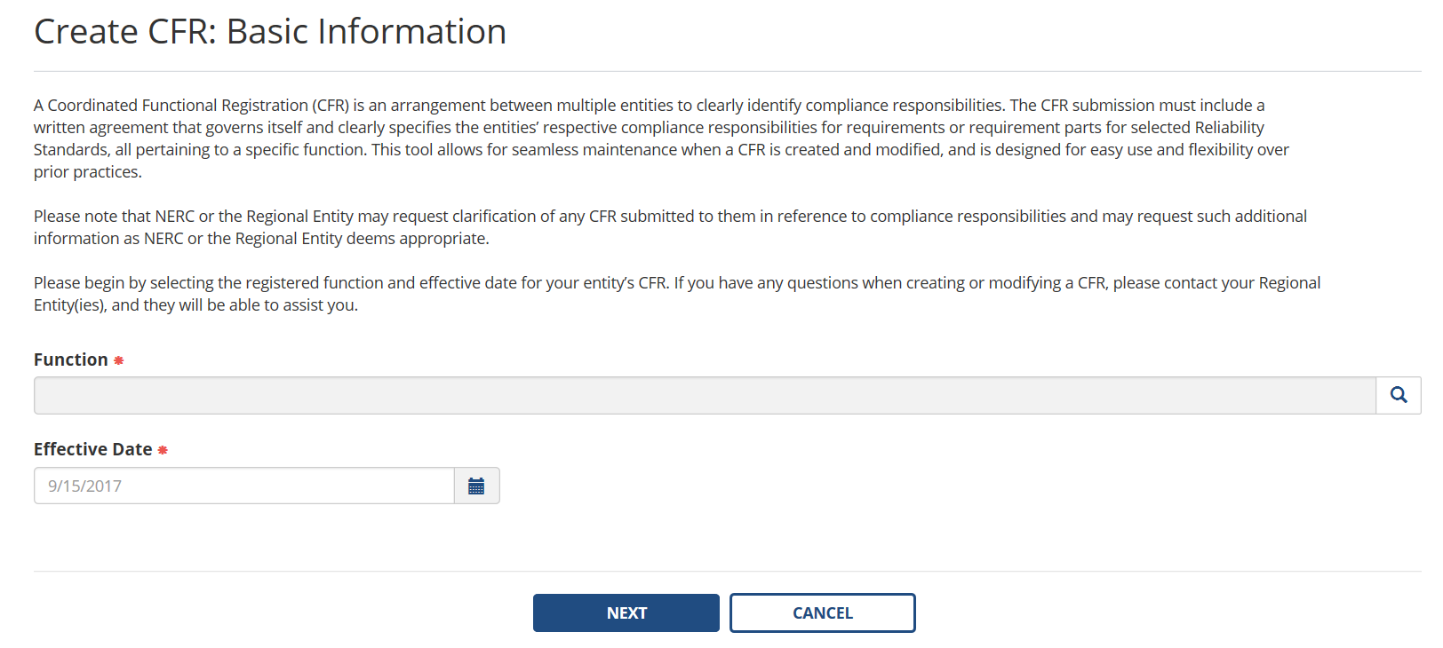
Basic CFR Information
Select a Function
Select the CFR Effective Date
Select Next to continue

Slide 42
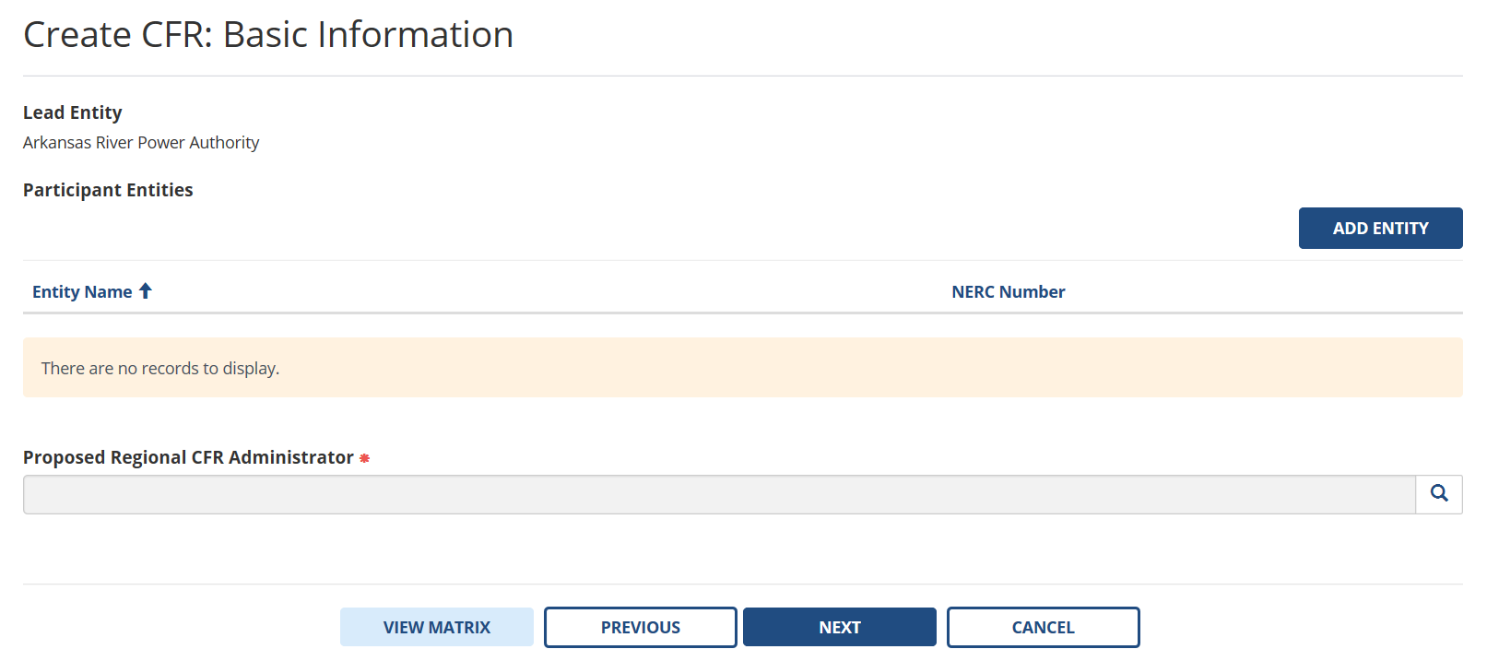
Participating Entities
Add Participating Entities
Select the Regional Entity that will oversee this CFR
Select Next to continue

Slide 43
Regional CFR Administrator
Select the Regional Entity (RE) you feel should oversee this CFR
  This is not 1 person but all authorized contacts associated with the RE
  The impacted regions will review and ultimately make final decision

Slide 44
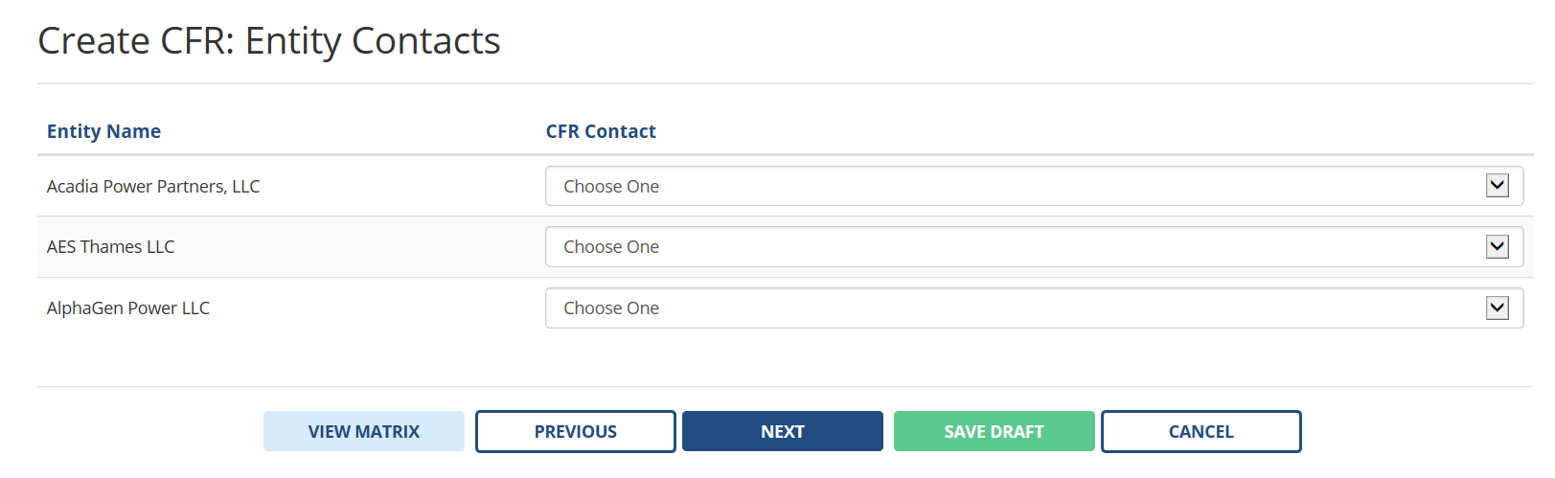
Add Participating Entity Contacts
Select a contact for each Participating Registered Entity

Slide 45
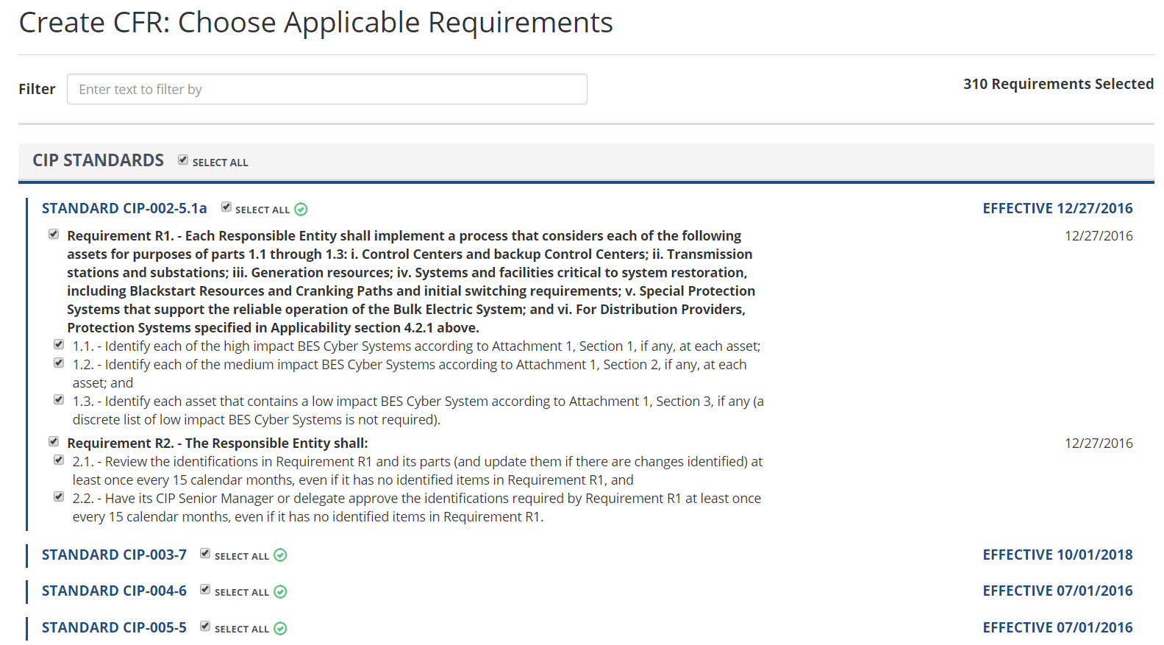
Choose Applicable Standards
Select the desired standard(s)

Slide 46
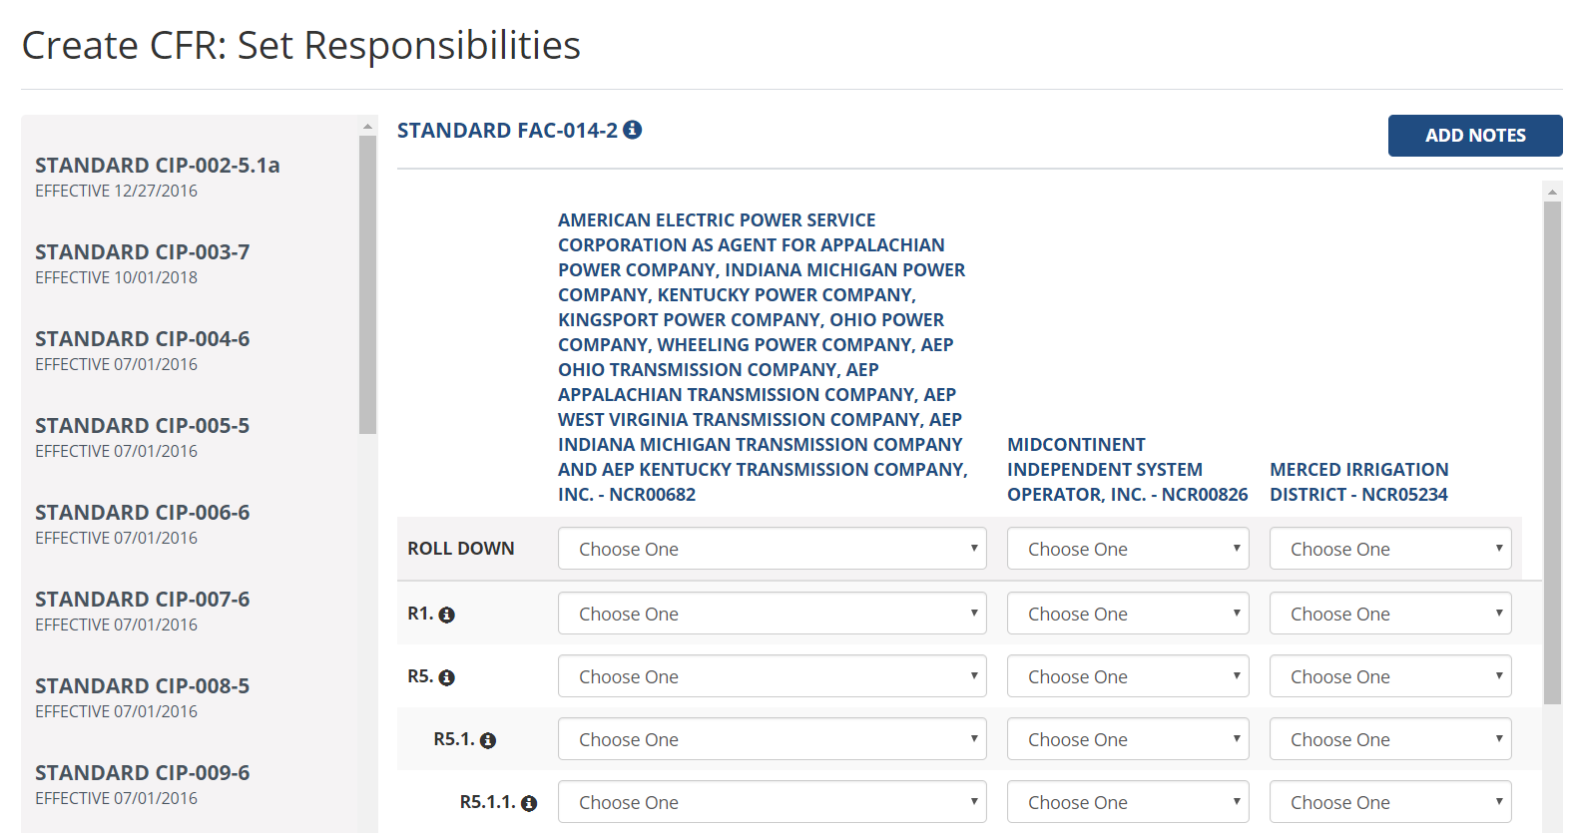
Set Entity Responsibility
Select the desired level of responsibility for each registered entity
Select Next to continue

Slide 47
Entity Responsibility Choices
Partial – entity is partially responsible
  Notes are required (if partial is selected for requirement or sub-requirement)
Full – entity is completely responsible
  Other entities are set to none
Normal – entity has the default legal responsibility
N/A – not applicable to the entity
None – entity has no responsibility
  Other entities are set to Full
Roll Down option –
  Choices made for first row can be applied for each following row
  Notes has similar option

Slide 48
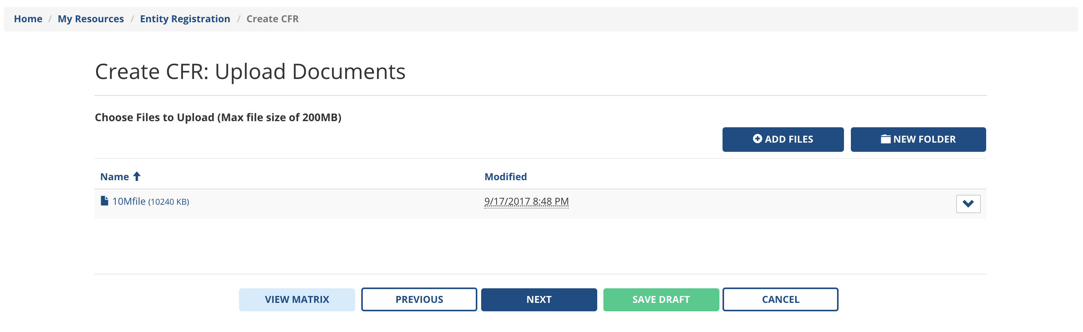
Upload Document(s)
Select option to Add Files
  max file size is 200 MB
  documents maybe removed
Select next to continue

Slide 49
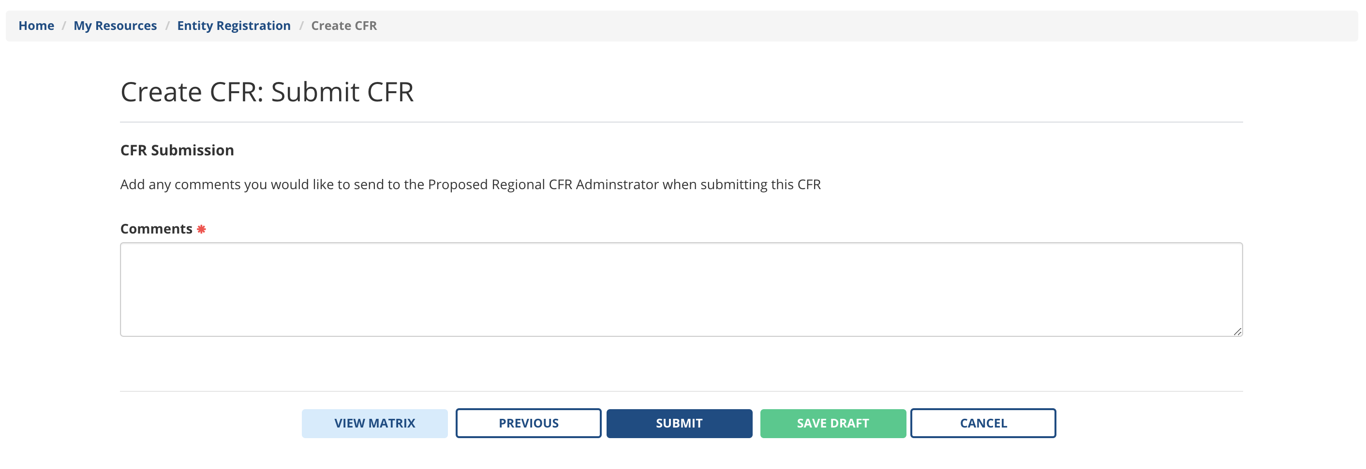
Submit CFR
Enter desired comments and select submit

Slide 50
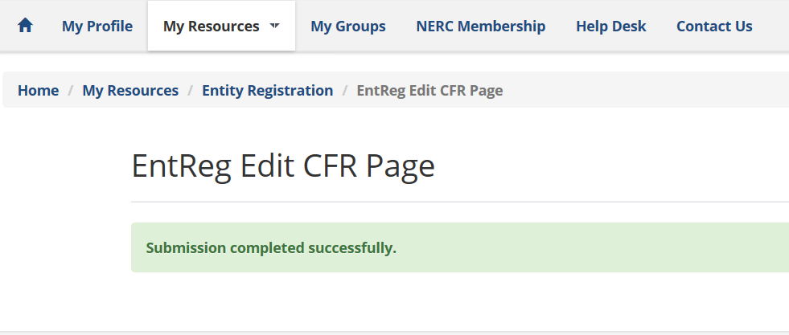
Successful Submission
Regional Entity users can now view and take action on the CFR

Slide 51
Viewing a CFR

Slide 52
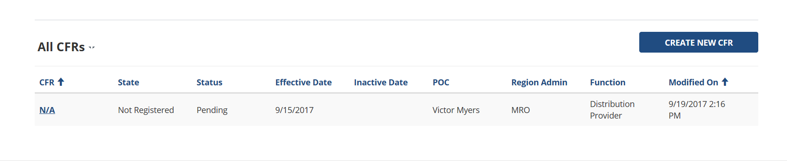
CFR Landing Page with CFRs to View
Click hyperlink to open desired record
  CFR details are displayed as view only see next slide
  Ability to view CFR Matrix
  Ability to view Entity Contacts
  Ability to download CFR Matrix

Slide 53
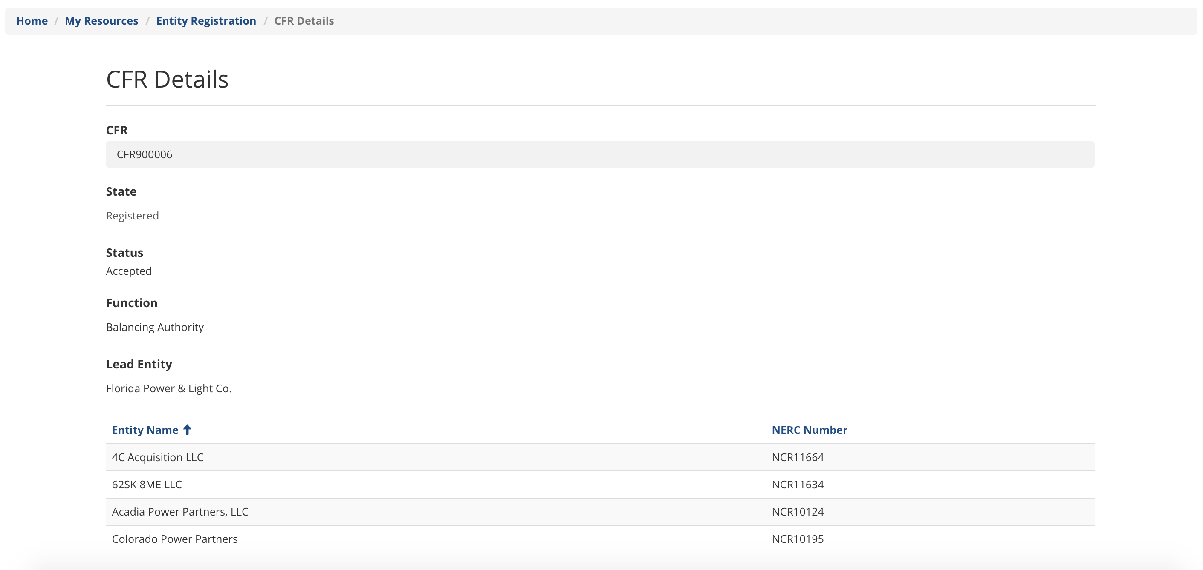
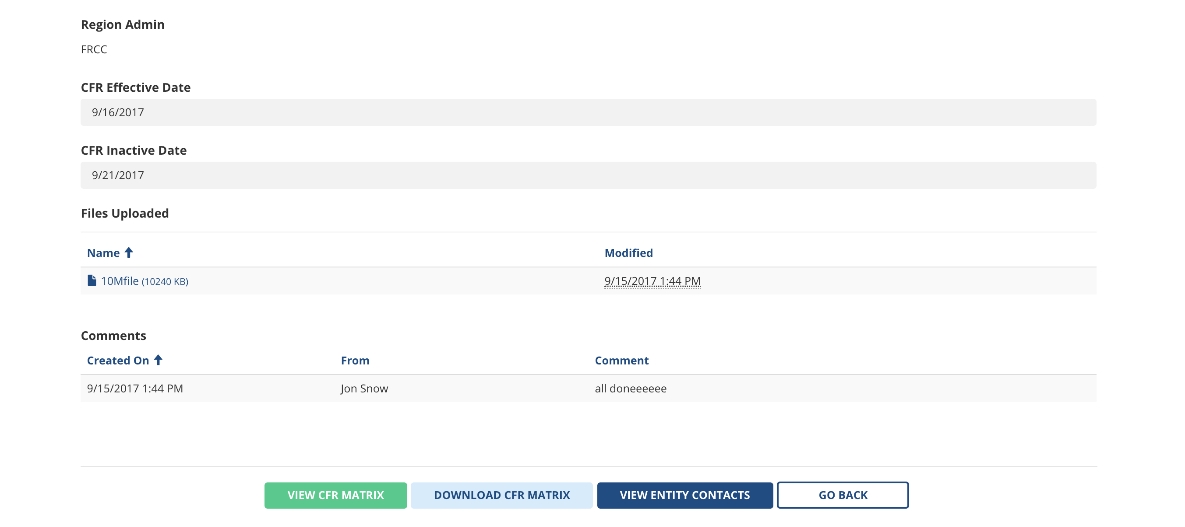
View CFR Details

Slide 54
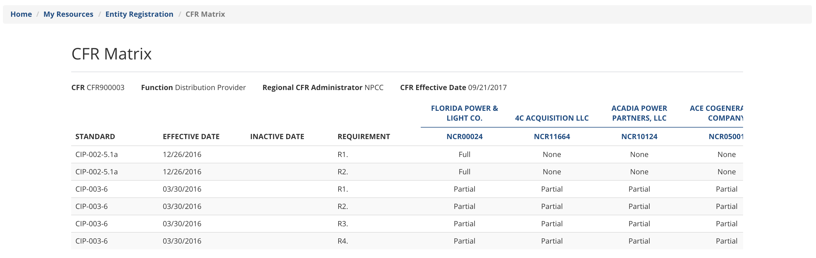
View CFR Matrix
Click “View CFR Matrix” and the page below opens
Click “Download CFR Matrix” and the information above will appear in an excel spreadsheet

Slide 55
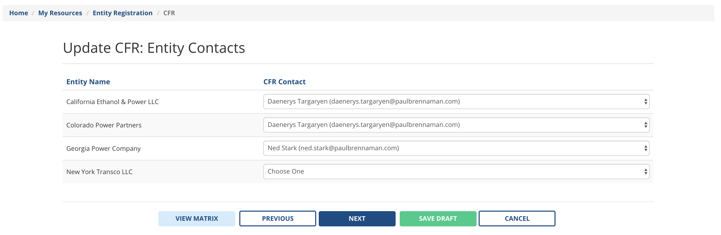
View Entity Contacts
Click View Entity Contacts and the participating entity contacts you selected for this CFR will be shown, see below.

Slide 56
Associating Contacts to Entities

Slide 57
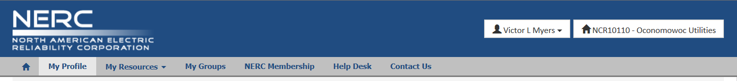
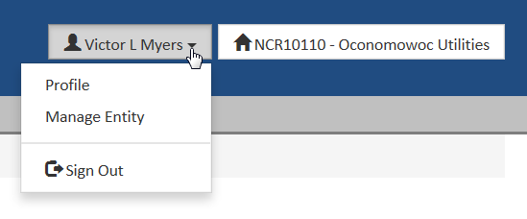
Manage Entity
In top right corner of the eroportal, displays your name and entity
Following your name, click drop down arrow, the options below appear
Click Manage Entity, that page opens on the next slide

Slide 58
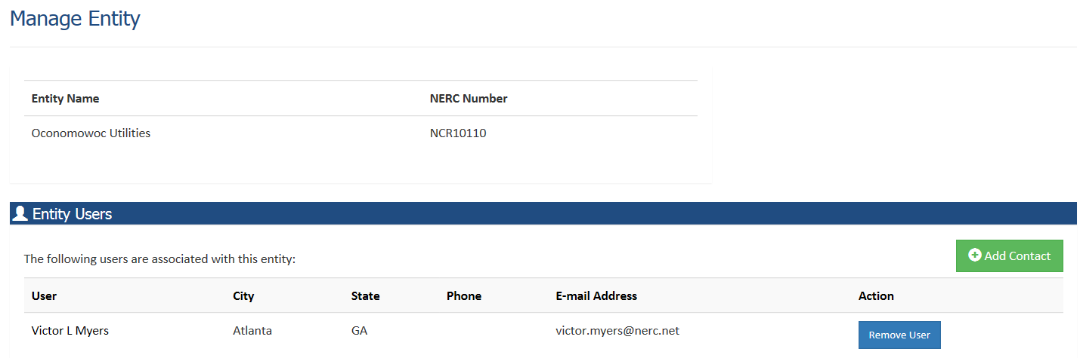
Manage Entity – Landing Page
The entity name and list of contacts shows below
Add/Remove contact
  Remove -> the user is no longer associated with this entity
  Add -> associates the user with this entity
    See next slide

Slide 59
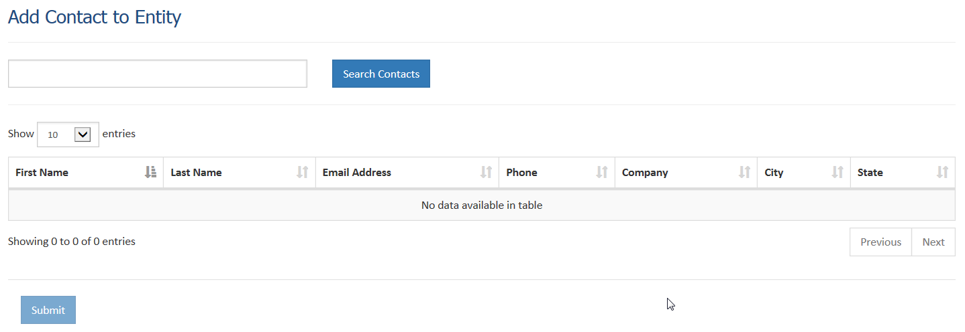
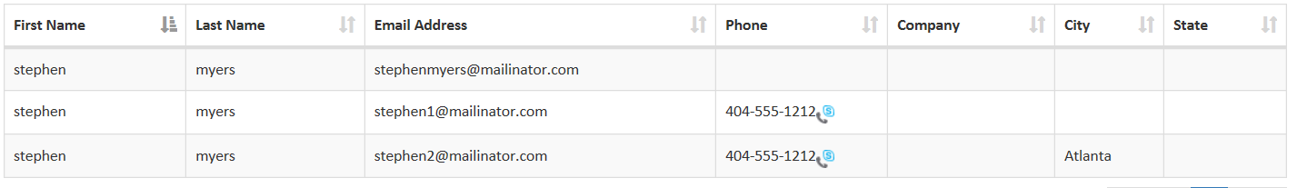
Associate Contact – Landing Page
Enter name, click search
select name, click submit, see next slide
  desired name doesn’t appear when you click search, contact your regional entity who would then contact NERC

Slide 60
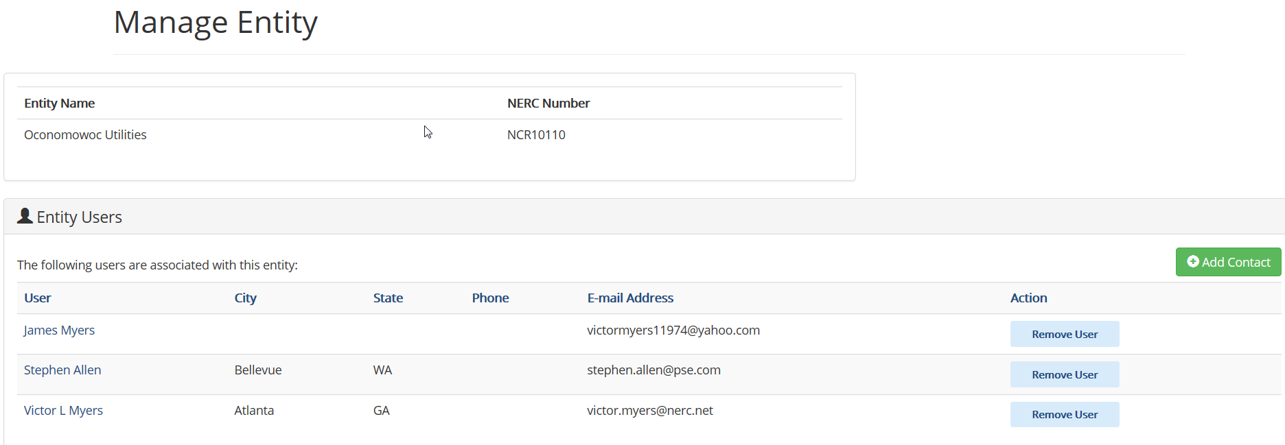
Associate Contact – Updated Landing Page

Slide 61
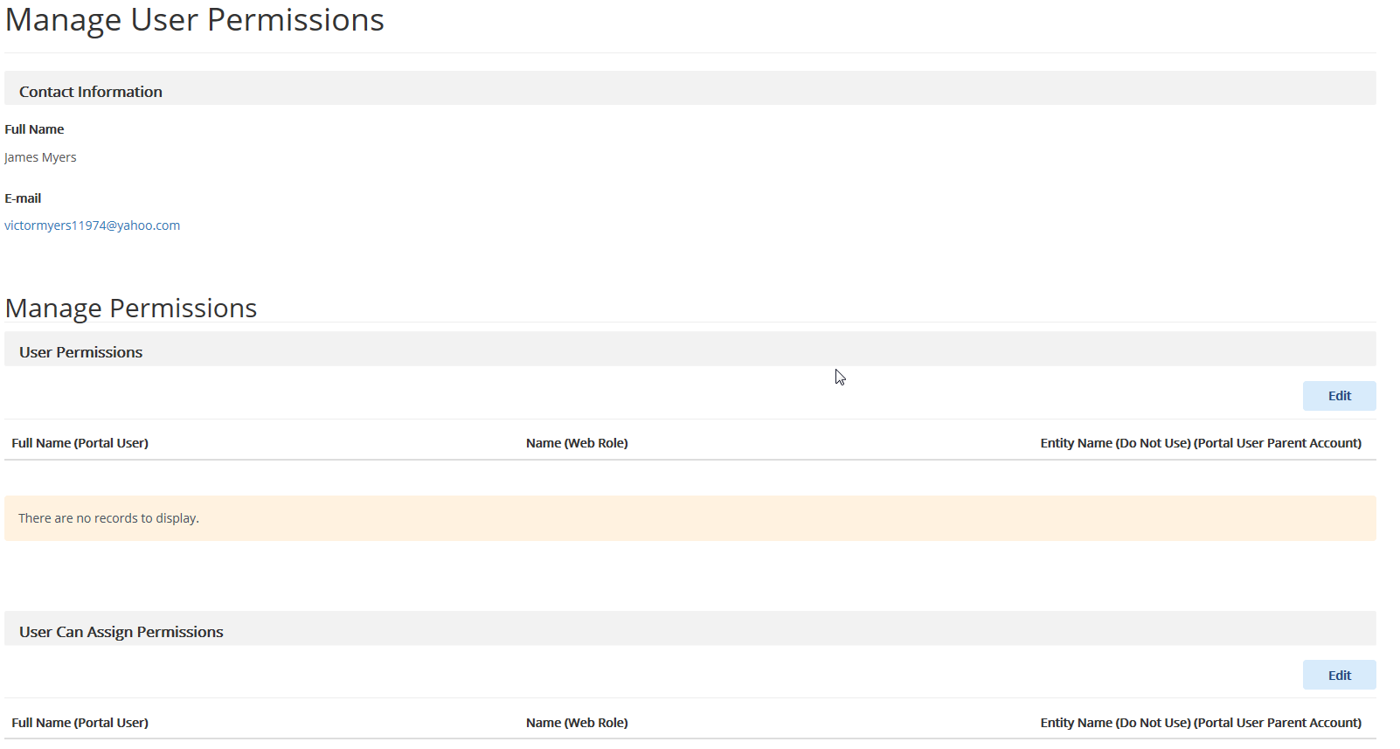
Associate Contact – Grant Permissions
Click any user’s name from the list shown on previous slide, this page opens:

Slide 62
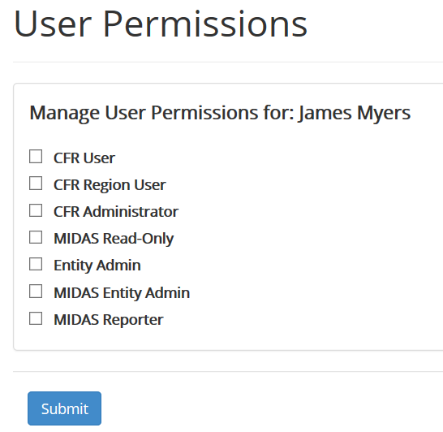
Give Permissions to the user
Click Edit next to the User Permissions sections (on slide 61), this page opens:
CFR Admin -> allows this user to grant CFR access to other users
CFR User -> allows user to access the CFR portal
Click Submit to save

Slide 63
Allow user to Assign Permissions
Click Edit next to the User Can Assign Permissions sections (on slide 61), this page opens:
CFR Admin -> allows this user to give another user the ability to grant CFR access
CFR User -> allows user to grant another user access to the CFR portal
Click Submit to save

Slide 64
Regional Entity Users – Review CFR
Once the CFR POC submits the CFR
  All Regional Entity users will have ability to view the CFR details
  Proposed Regional CFR Administrator has ability to:
    Accept
    Reject
    Return CFR with comments
    Change Proposed CFR Administrator

Slide 65
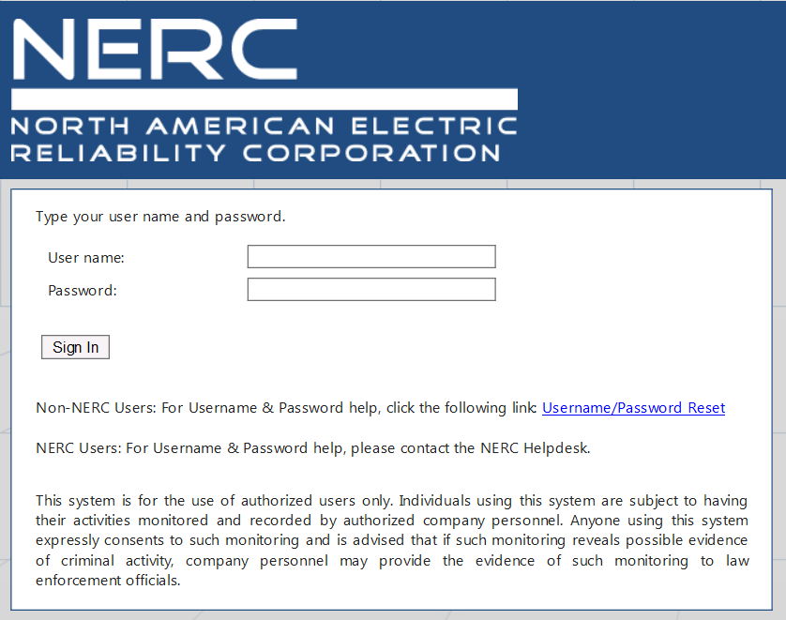
Regional Entity Users – Login to CRM
Staging address:
  https://xrmstg.nerc.net
Production address:
  https://xrm.nerc.net

Slide 66
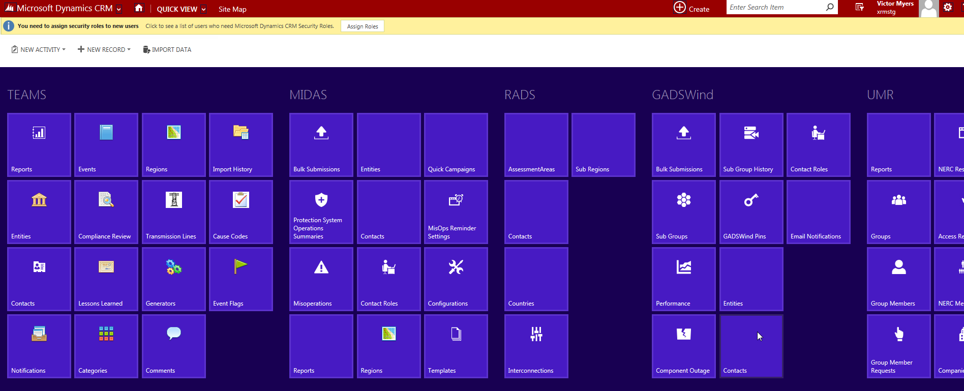
CRM Landing Page

Slide 67
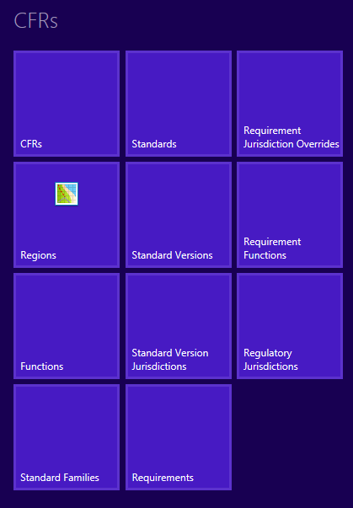
CFR Menu

Slide 68
Regional Entity view list of CFRs

Slide 69
CFRs
Click CFRs shown above

Slide 70
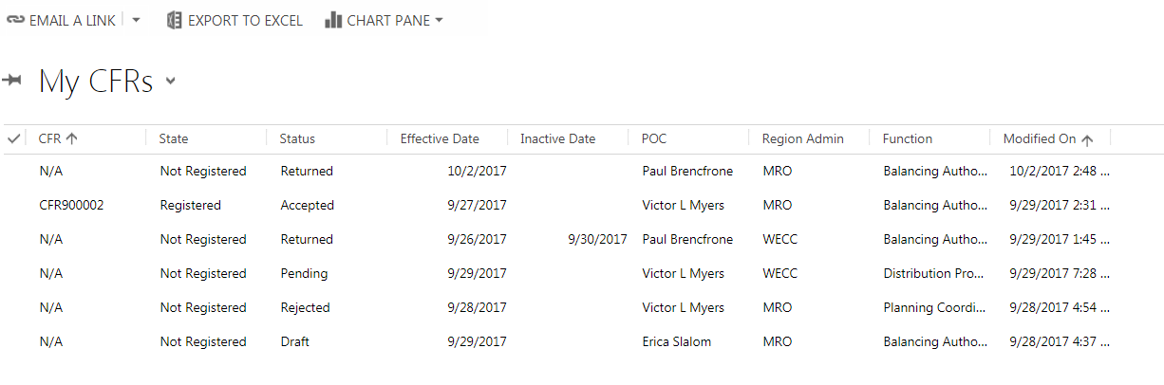
Your CFRs are Displayed
The system shows all CFRs for your region

Slide 71
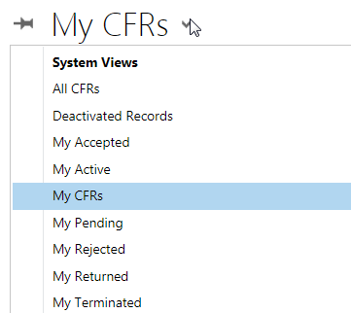
Different CFR Views
You can custom your view by clicking the arrow next to My CFRs

Slide 72
Regional Entity Returns CFR

Slide 73
Pick desired CFR
Regional Entity user clicks the desired CFR from list

Slide 74
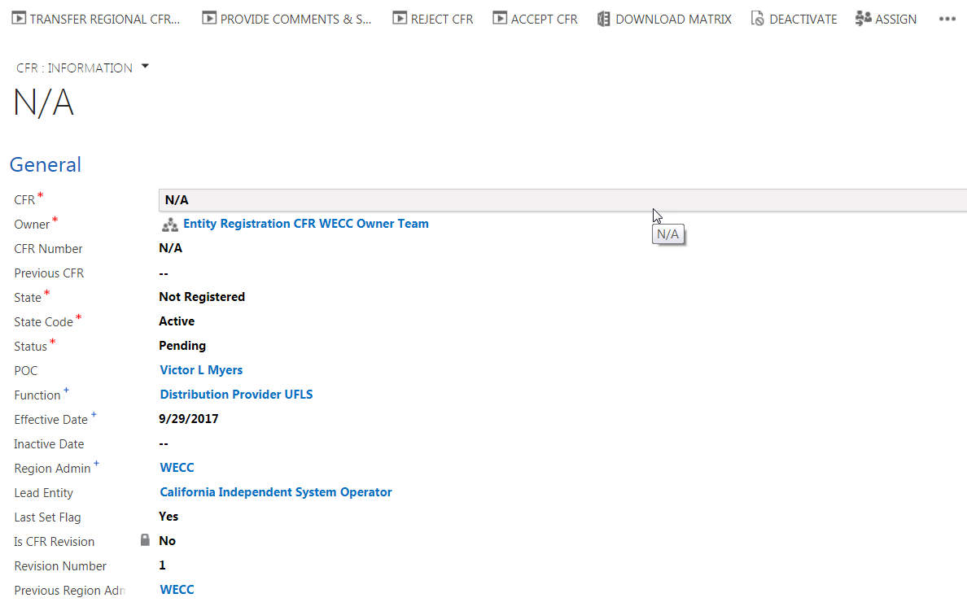
CFR Details

Slide 75
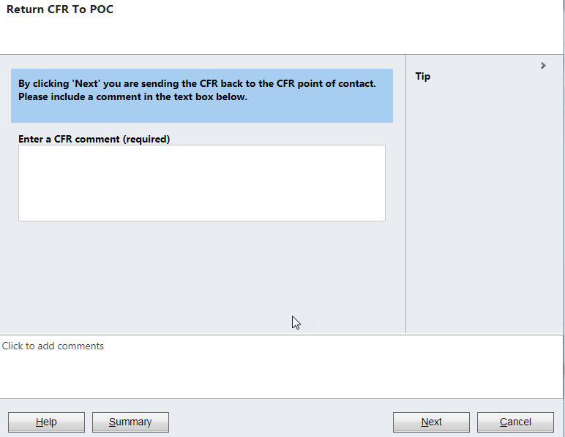
Return CFR
Regional Entity user clicks button to Provide Comments & Return CFR
Regional Entity user must enter a comment and click next then finish to complete the return

Slide 76
Registered Entity After CFR is Returned

Slide 77
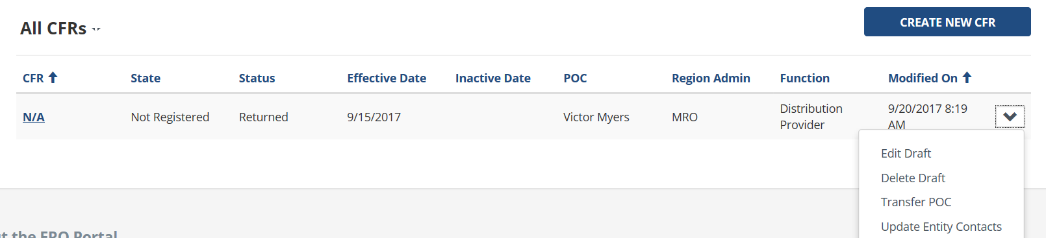
CFR is Returned with Comments
If the Proposed Regional CFR Administrator returns the CFR your CFR landing page will look like the example shown below and you will be able to perform:
  Edit CFR
  Delete CFR
  Transfer POC
  Update Participating Entity Contacts

Slide 78
Returned CFR – Edit CFR
Once you select Edit Draft
The pre-populated CFR opens and you are able to step through each section of the CFR and make revisions
  Function can be changed, since CFR hasn’t been approved yet
  Proposed Regional CFR Administrator can be changed
Click submit when finished

Slide 79

Returned CFR – Delete CFR
Once you select Delete Draft
System prompts to ensure you want to delete
Click delete, that CFR is removed from the system

Slide 80

Returned CFR - Transfer POC
Once you select Transfer POC
Choose the desired entity
Choose the desired contact, click transfer

Slide 81
Regional Entity Accepts CFR

Slide 82
Pick desired CFR
Regional Entity user clicks the desired CFR from list

Slide 83
CFR Details

Slide 84

Accept CFR
Regional Entity user clicks button to Accept CFR
Regional Entity user must click next then finish to complete the acceptance

Slide 85
Registered Entity After CFR is Accepted

Slide 86

CFR is Registered
If the Proposed Regional CFR Administrator accepts the CFR your CFR landing page will look like the example shown below and you will be able to perform:
  Transfer POC
  Update Participating Entity Contacts
  Update CFR
  Terminate CFR
  Clicking hyperlink opens CFR details in view only mode

Slide 87

Create a new CFR version
Once you select Update CFR
Click continue
The pre-populated CFR opens and you are able to step through each section of the CFR and make revisions
  Function cannot be changed
  Proposed Regional CFR Administrator can be changed

Slide 88
Transfer POC
Once you select Transfer POC
Choose the desired entity
Choose the desired contact, click transfer

Slide 89

Update Participating Entity Contacts
Once you select Update Entity Contacts
Use drop down to choose the desired contact for each entity
Click save

Slide 90
Regional Entity Rejects CFR

Slide 91
Pick desired CFR
Regional Entity user clicks the desired CFR from list

Slide 92
CFR Details

Slide 93

Reject CFR
Regional Entity user clicks button to Reject CFR
Regional Entity user must enter a comment, then click next then finish to complete the rejection

Slide 94
Registered Entity After CFR is Rejected

Slide 95

Rejected CFR
Only option available is to view the CFR, click hyperlink shown below

Slide 96
Regional Entity Transfers CFR Administrator

Slide 97
Pick desired CFR
Regional Entity user clicks the desired CFR from list

Slide 98
CFR Details

Slide 99

Transfer CFR Administrator
Regional Entity user clicks button to Transfer Regional CFR Administrator
Regional Entity user must select another CFR Administrator
Regional Entity user may enter a comment, then click next then finish to complete the rejection
No effect on CFR POC

Slide 100
Email Messages

Slide 101
Email Notifications
When these actions occur an email is sent:
  CFR is submitted
  CFR is updated/revised
  CFR POC is transferred
  Entity Contacts on CFR are updated
  Proposed Regional CFR Administrator send comments back on CFR
  Proposed Regional CFR Administrator accepts CFR
  Proposed Regional CFR Administrator rejects CFR
  Proposed Regional CFR Administrator transfers CFR to another Regional Administrator
  NERC sends a request to update standards associated with a CFR
  NERC sends a request to update a function associated with a CFR

Slide 102

CFR Accepted Email
Recipients:
  CFR POC
  Contacts for the Entities Participating in the CFR
  NERC CFR Administrator
  Impacted Regional Entity contacts
Example of the email:

Slide 103

CFR Rejected Email
Recipients:
  CFR POC
  Contacts for the Entities Participating in the CFR
  NERC CFR Administrator
  Impacted Regional Entity contacts
Example of the email:

Slide 104

CFR Submitted Email
Recipients:
  CFR POC
  Contacts for the Entities Participating in the CFR
  Impacted Regional Entity contacts
Example of the email:

Slide 105

CFR Termination Email
Recipients:
  CFR POC
  Contacts for the Entities Participating in the CFR
  Impacted Regional Entity contacts
Example of the email:

Slide 106

CFR Returned to POC Email
Recipients:
  CFR POC
  Contacts for the Entities Participating in the CFR
  Impacted Regional Entity contacts
Example of the email:

Slide 107

CFR POC has changed Email
Recipients:
  CFR POC
  Contacts for the Entities Participating in the CFR
  Previous CFR POC
Example of the email:

Slide 108

Proposed Regional CFR Administrator has changed Email
Recipients:
  CFR POC
  Regional Entity contacts
Example of the email:

Slide 109
Request for a Standard Update Email
Recipients:
  CFR POC
  Participating Entity contacts
NERC is able to customize the contents of the email

Slide 110
Request for a Function Update Email
Recipients:
  CFR POC
  Participating Entity contacts
NERC is able to customize the contents of the email

